Slide 1


Sign Language Interpreter
Mani Surya Teja Kota
This Photo by Unknown author is licensed under CC BY-SA.

Slide 2
Table of Contents
Objective
Survey
Data Preparation
Workflow
Features Extraction
Training YOLOv5
Results
Confidence
Confusion Matrix
Testing Accuracy
Team Contributions
Demo

Slide 3

Why Sign Language Interpreter?
To build a effective communication between the mute and blind people.
What does the Sign Language Interpreter good?
Recognise the signs of a mute person and generates a note from it and will convey to the blind person.

Slide 4
Dataset Preparation
Dataset from Roboflow : https://universe.roboflow.com/majorproject-25tao/american-sign-language-v36cz/dataset/2/images?split=train
Downloaded format – Pascal Voc
Converted the XML -> txt, and will the model with extracted features from xml

Slide 5
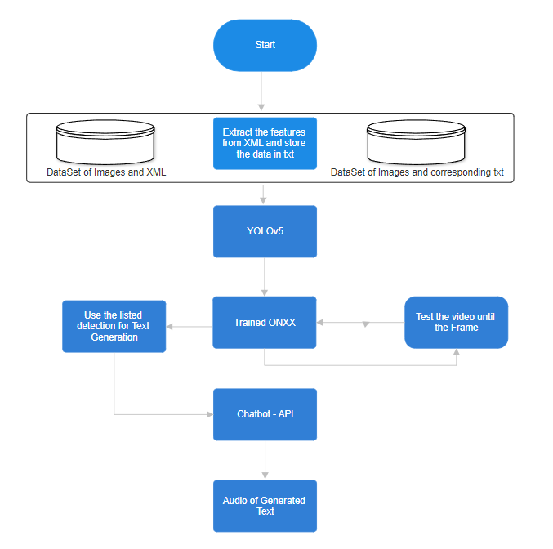
Workflow of Sign Language Interpreter

Slide 6
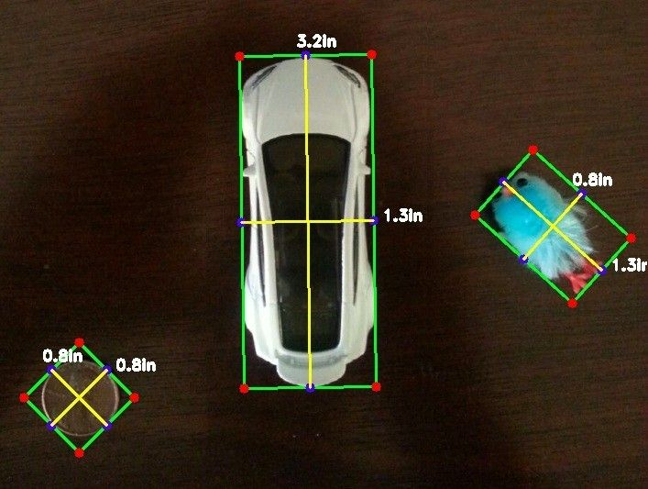
Features Extraction
X-center and Y-centers of the detected objects in image over whole image, Length and Height of object over whole image and the class_label.
X-center : ((Xmin + Ymax)/2)/(length of image)
Y-center : ((Ymin + Ymax)/2)/(width of image)
Length of object : (Xmax – Xmin)/(length of image)
Width of object : (Ymax – Ymin)/(width of image)
Labels : which are numbers from
0-(no.of classes –1)
These features of every object in the image are stored in a txt with space separated values and will use them to train the YOLOv5 model.

Slide 7
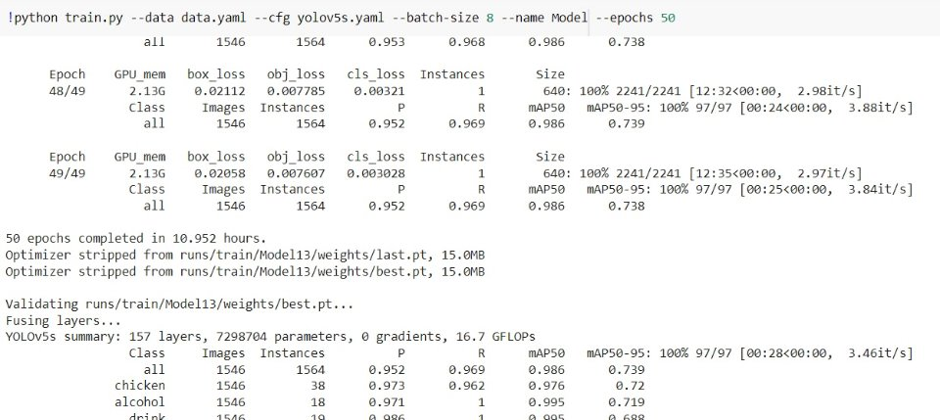
Training YOLOv5
Dataset : Over 20K+ images with 106 classes (1.2GB Approx)
Time Constraint :
Model : YOLOv5
Model Size :
Tools : Anaconda Jupyter - for feature Extraction and to Test the model
Google collaboratory – To Train the model.

Slide 8
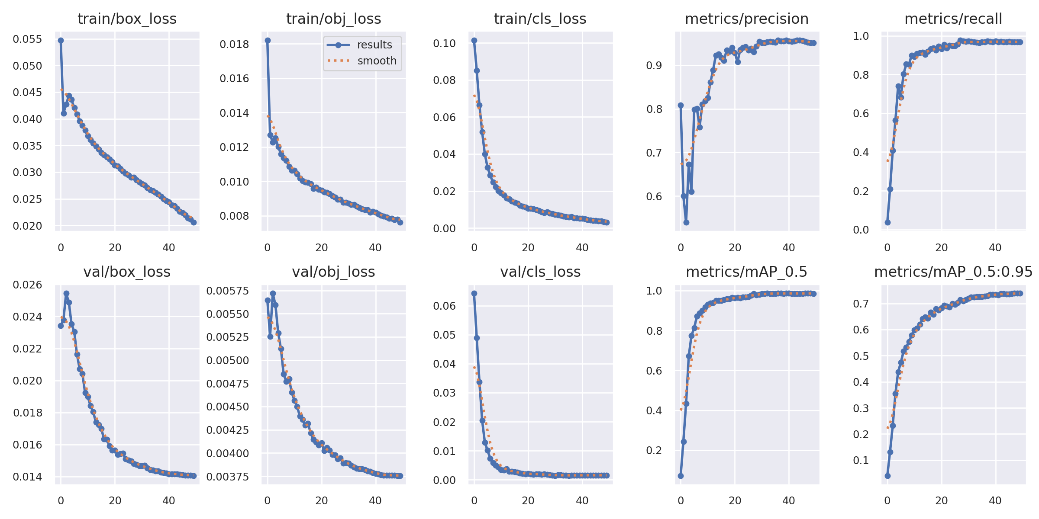
Results:

Slide 9
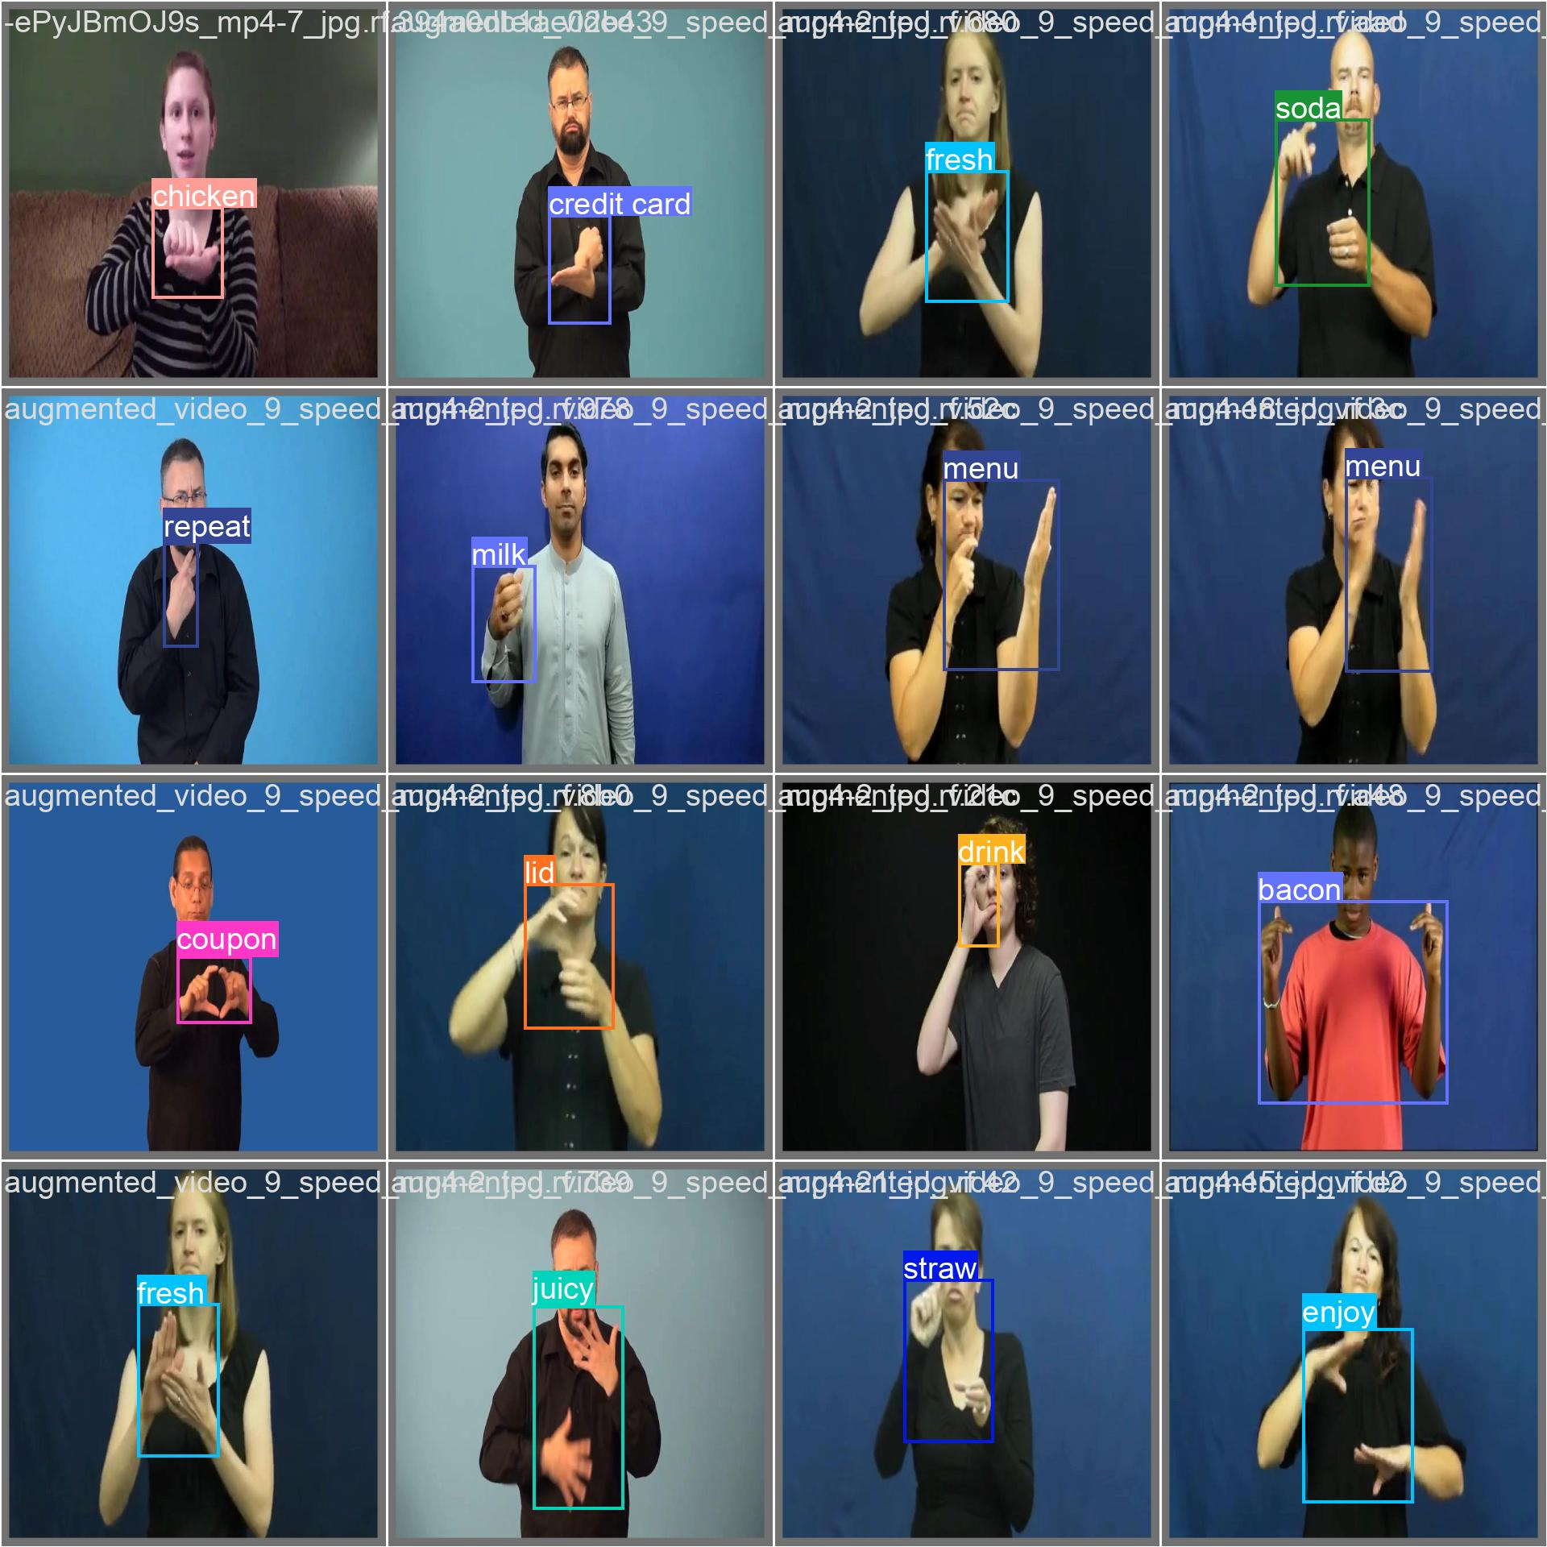
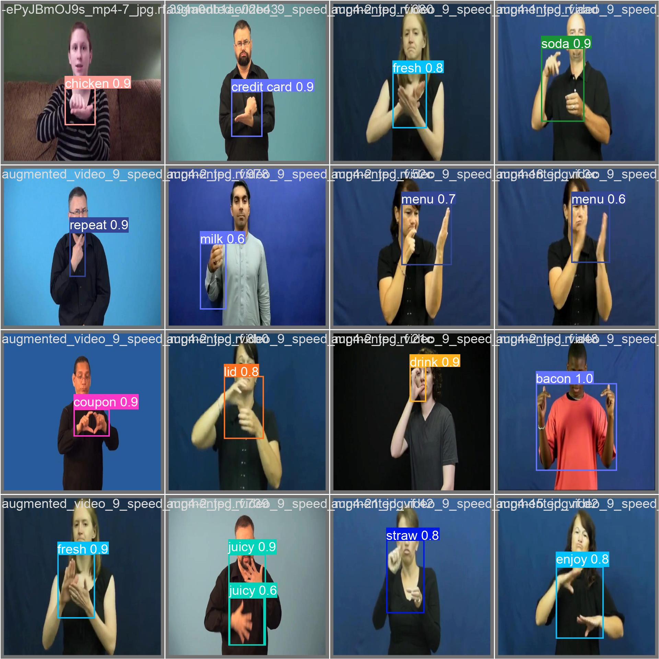
confidence

Slide 10
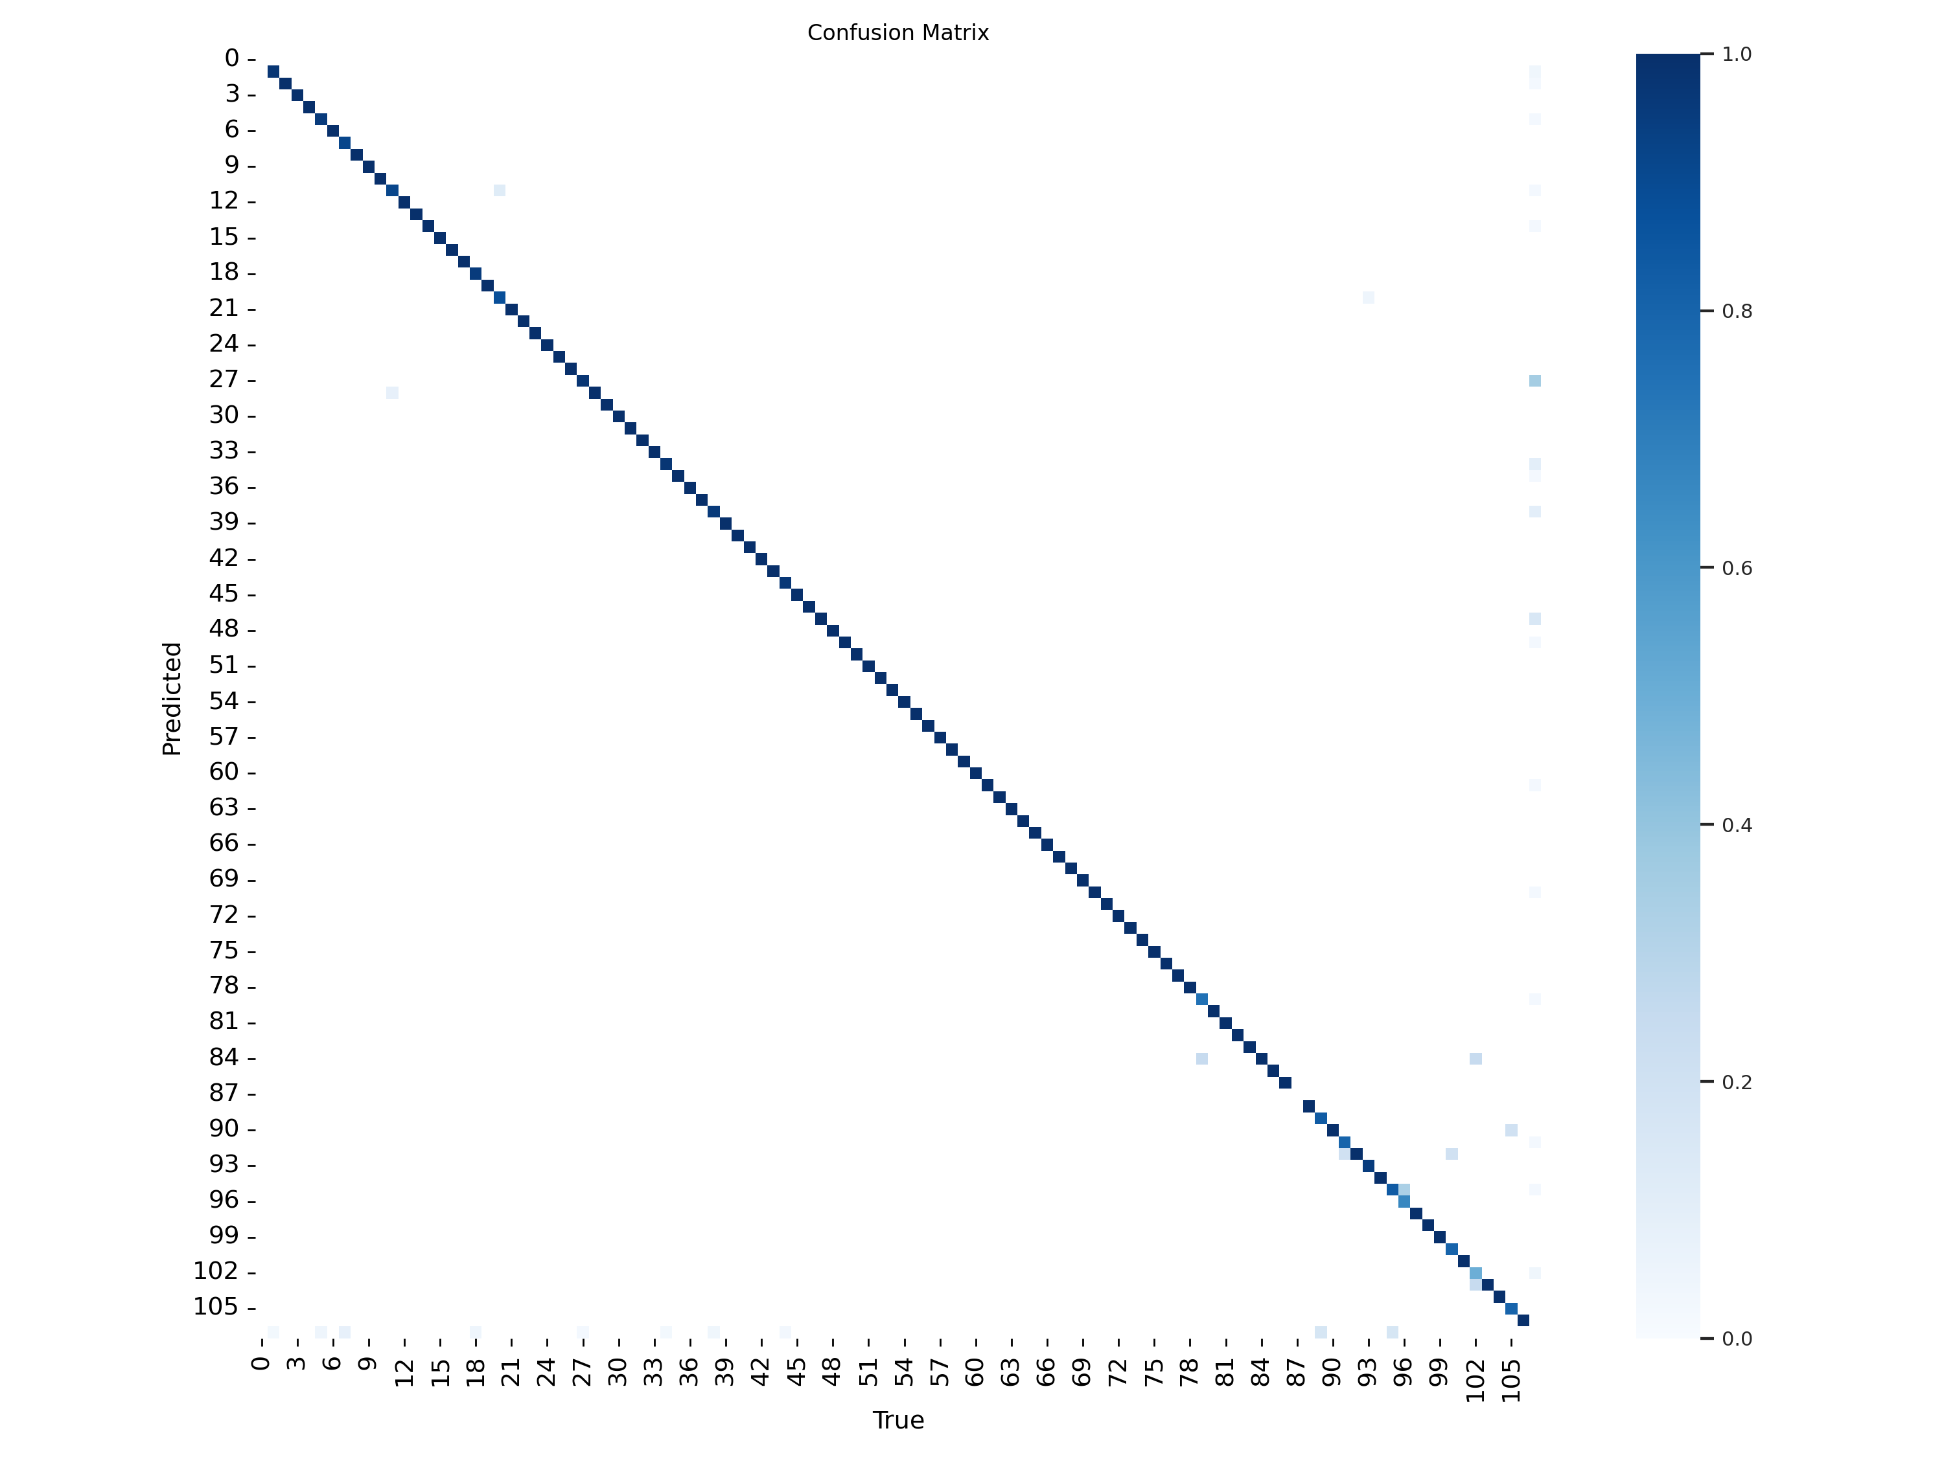
Confusion matrix

Slide 11
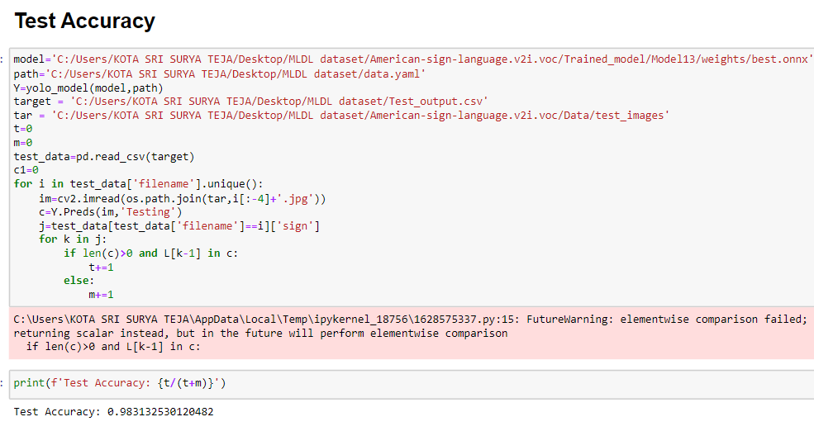
Testing Accuracy

Slide 12

Demo

